Slide 1









GROUP 4
Vegetables

Slide 2



Introduction
This dataset captures the price fluctuations of various vegetables over the year 2023,offering insights into market trends,seasonal impacts and overall price volatility.The data encompasses details like the vegetable name,unit price.By analyzing this dataset,we can uncover patterns in vegetable pricing, evaluate the influence of external factors like weather or economic conditions, and predict future price trajectories.

Slide 3

PROBLEM_STATEMENT
Vegetable prices fluctuate significantly making it difficult for farmers,retailers and consumers to plan and make informed decisions.Factors such as seasonality,Logistics and changing demand patterns contribute to price volatilite

Slide 4


Determine which months have the highest and lowest prices for each vegetable.This could help retailers and consumers plan ahead by purchasing or storing vegetables when prices are lower.
OBJECTIVES
Calculate the average price for each vegetable to establish a baseline for cost expectations.
.
Examine the correlation between vegetable prices to understand how changes in one commodity affect the prices of others.

Slide 5



Salford & Co.
DATA CLEANING

Slide 6
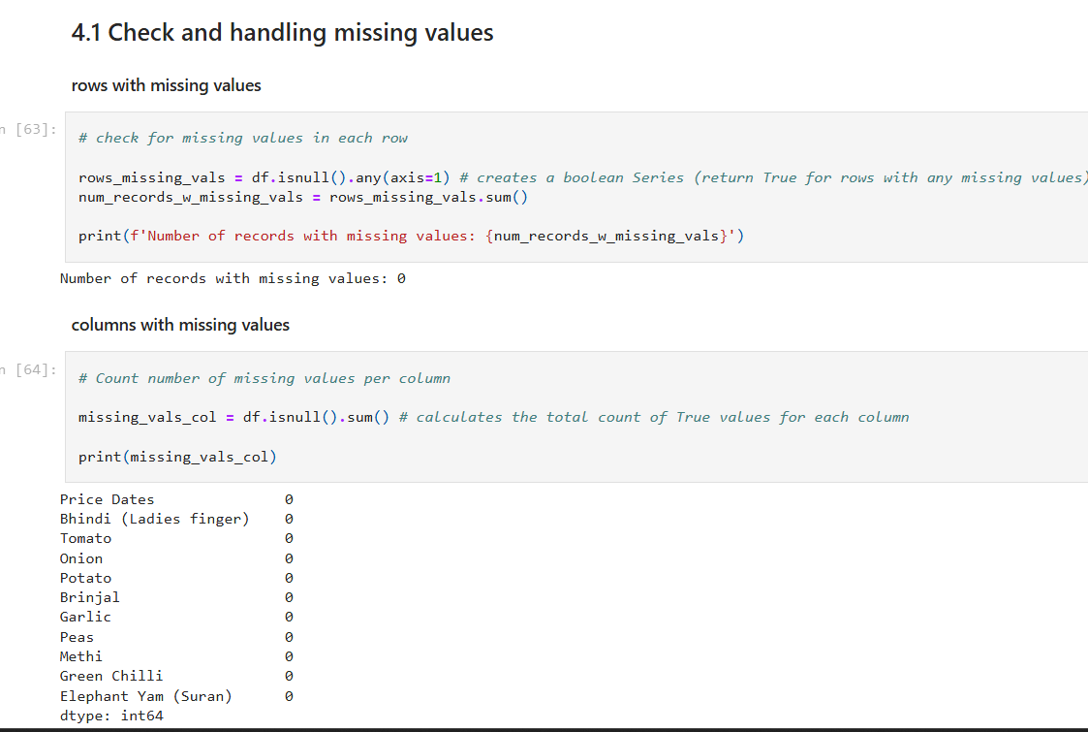

Slide 7
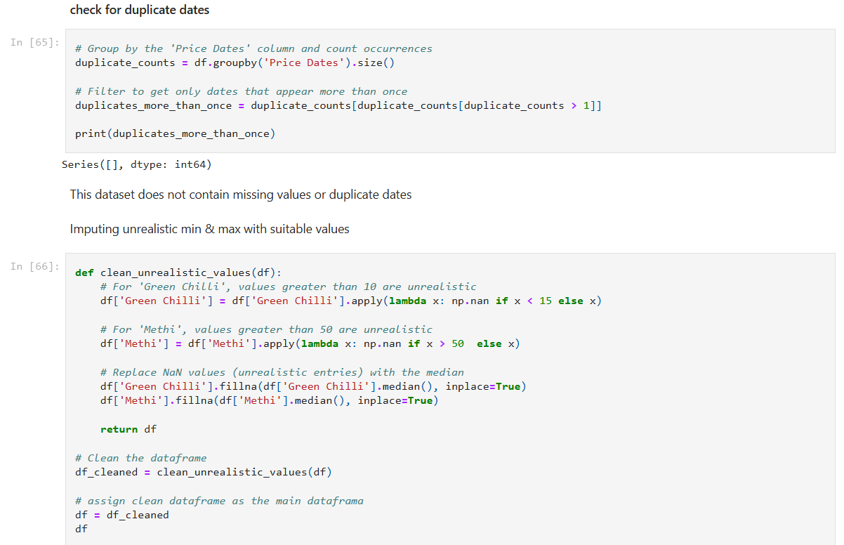

Slide 8
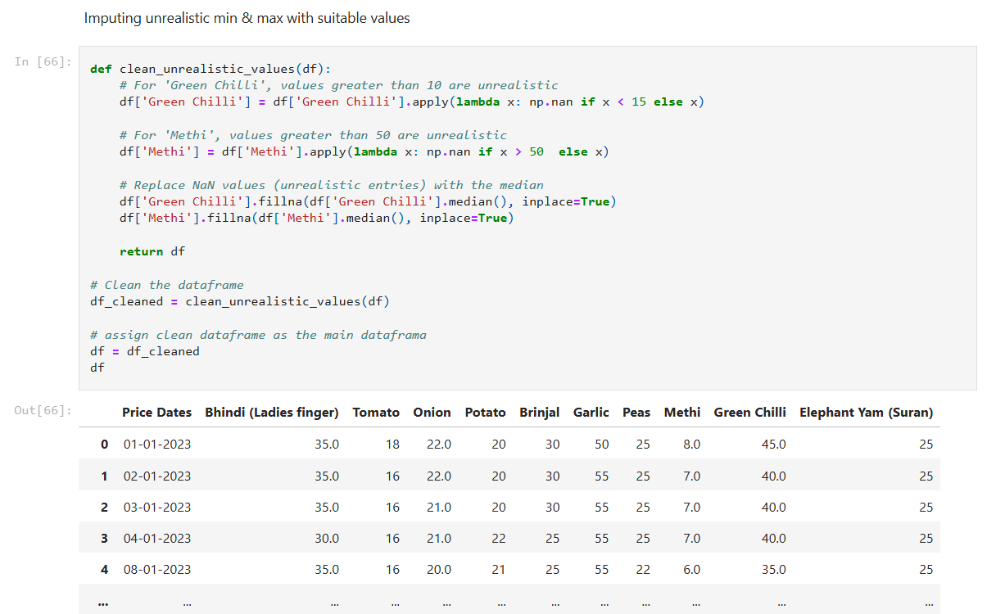

Slide 9
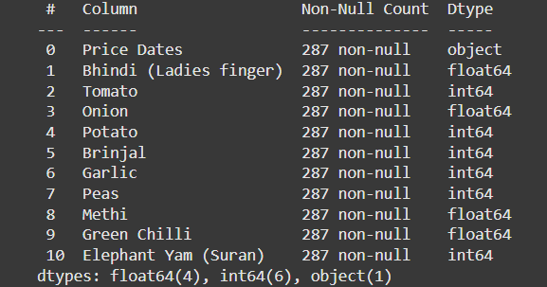


EDA

Slide 10
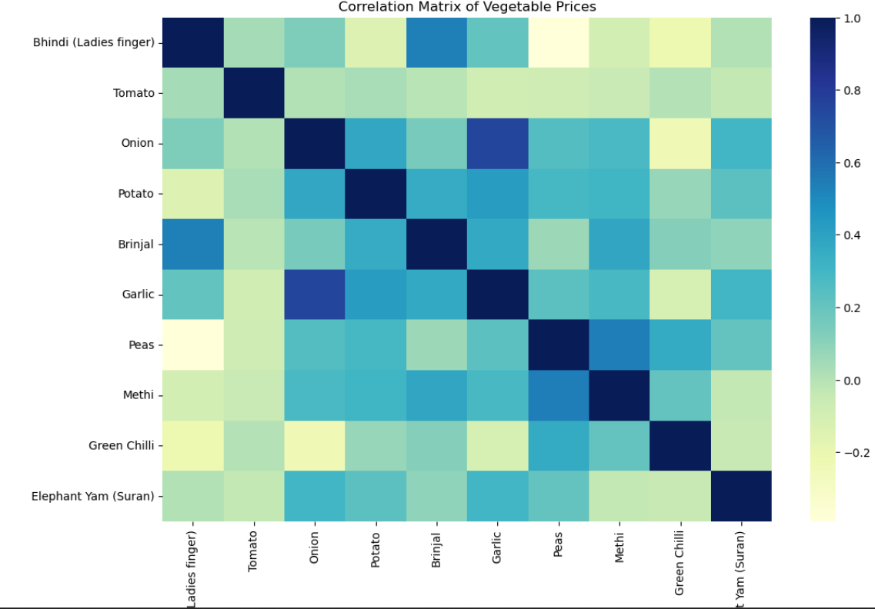
HEAT MAP

Slide 11
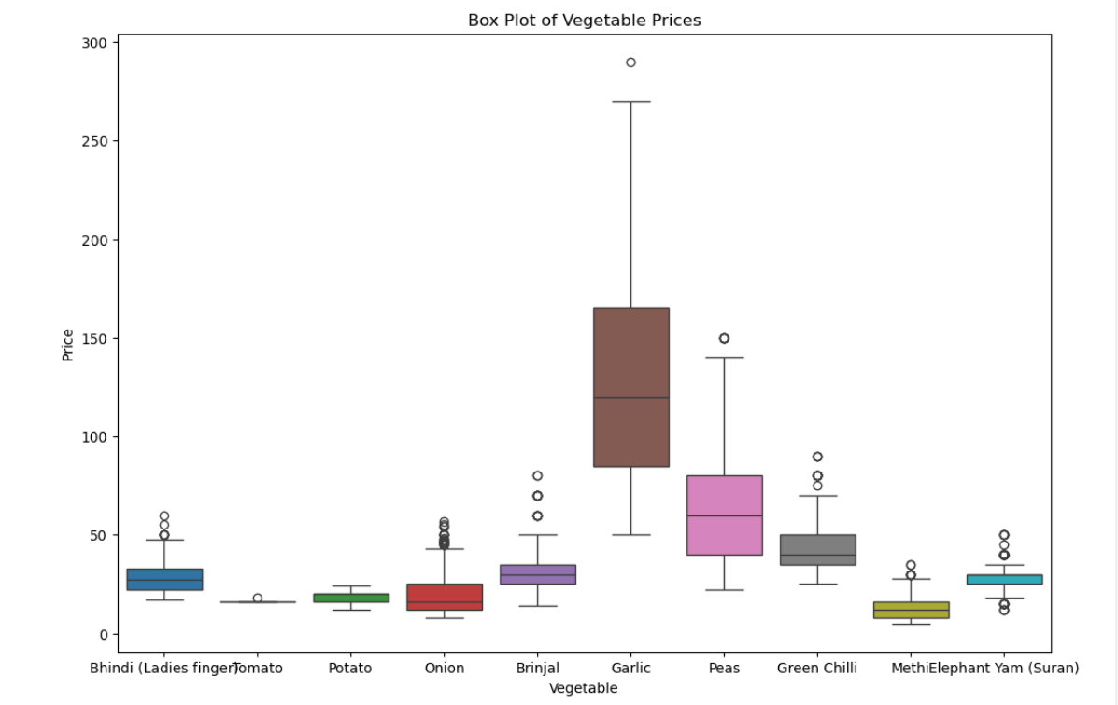

Slide 12
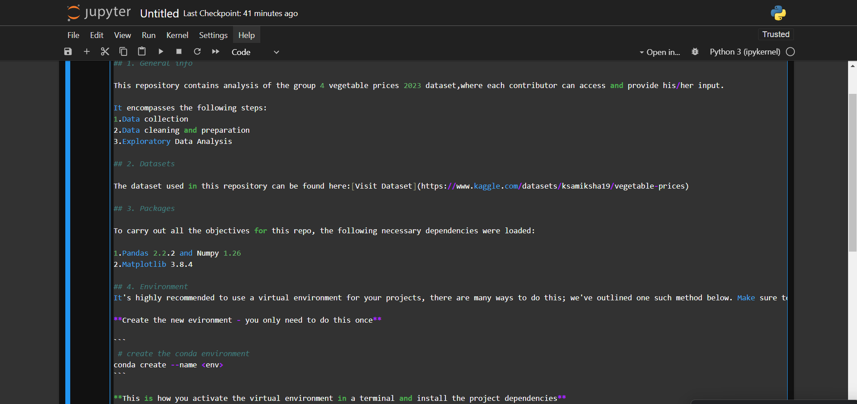

Slide 13
Salford & Co.
off to the README
Thank You

